Slide 1
SemEval 2019 Subtask
Xihao liang
http://alt.qcri.org/semeval2019/index.php?id=tasks

Slide 2
Opinion, emotion and abusive language detection
Task 3: EmoContext: Contextual Emotion Detection in Text
Task 4: Hyperpartisan News Detection
Task 5: HatEval: Multilingual Detection of Hate Speech Against Immigrants and Women in Twitter
Task 6: OffensEval: Identifying and Categorizing Offensive Language in Social Media

Slide 3
Task 3: EmoContext: Contextual Emotion Detection in Text
Task Description
In this task, you are given a textual dialogue i.e. a user utterance along with two turns of context, you have to classify the emotion of user utterance as one of the emotion classes: Happy, Sad, Angry or Others. ​ ​
Data Set
The training data set will contain 15K records for emotion classes i.e., Happy, Sad and Angry combined.
It also contains 15K records not belonging to any of the aforementioned emotion classes.
https://www.humanizing-ai.com/emocontext.html

Slide 4
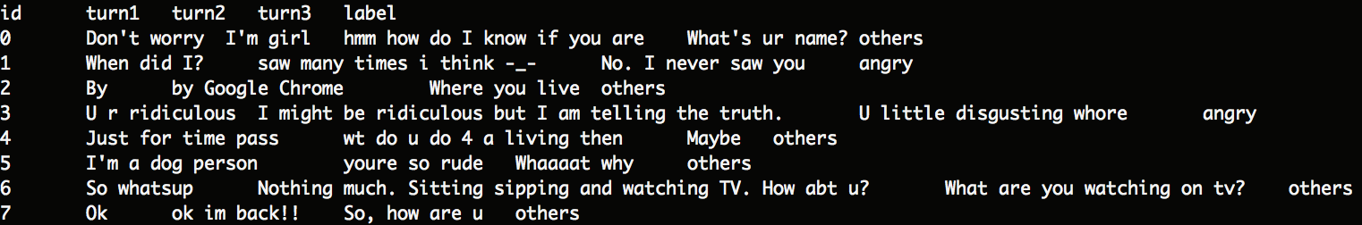
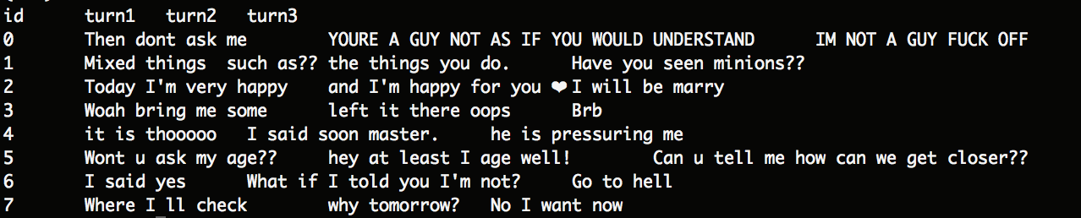
Task 3: EmoContext: Contextual Emotion Detection in Text
train.txt
devwithoutlabels.txt
Happy | Angry | Sad | Others
4243 | 5506 | 5463 | 14948

Slide 5
Task 4: Hyperpartisan News Detection
Task
Given a news article text, decide whether it follows a hyperpartisan(偏袒的) argumentation, i.e., whether it exhibits blind, prejudiced, or unreasoning allegiance(忠诚) to one party, faction, cause, or person.
Data (September 2018)
We will provide 1 million articles labeled by the overall tendency of the publisher for training your algorithm.
Upon registration we provide you with a trial dataset (may take up to 24 hours). We continuously clean the dataset (also based on your feedback) and will send you new versions as they come out.
https://pan.webis.de/semeval19/semeval19-web/

Slide 6
Task 5 - Shared Task on Multilingual Detection of Hate (hatEval)
Hate Speech is commonly defined as any communication that disparages (贬低) a person or a group on the basis of some characteristic
such as race, color, ethnicity, gender, sexual orientation, nationality, religion, or other characteristics.
The proposed task consists in Hate Speech detection in Twitter
featured by two specific different targets, immigrants and women
in a multilingual perspective, for Spanish and English.
https://competitions.codalab.org/competitions/19935

Slide 7
Task 5 - Shared Task on Multilingual Detection of Hate (hatEval)
TASK A - Hate Speech Detection against Immigrants and Women
a two-class (or binary) classification
whether a tweet in English or in Spanish with a given target (women or immigrants) is hateful or not hateful.
TASK B - Aggressive behavior and Target Classification
first to classify hateful tweets for English and Spanish (e.g., tweets where Hate Speech against women or immigrants has been identified) as aggressive or not aggressive
second to identify the target harassed as individual or generic (i.e. single human or group).

Slide 8
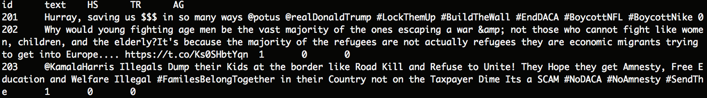
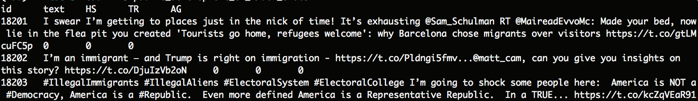
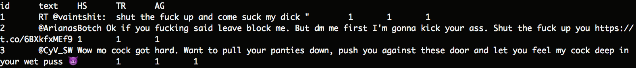
Task 5 - Shared Task on Multilingual Detection of Hate (hatEval)
public_development_en/train_en.tsv
public_development_en/dev_en.tsv
publich_trial/trial_en.tsv

Slide 9
Task 6: OffensEval: Identifying and Categorizing Offensive Language in Social Media
Motivation
Offensive language is pervasive in social media. Individuals frequently take advantage of the perceived anonymity(匿名) of computer-mediated communication, using this to engage in behaviour that many of them would not consider in real life. Online communities, social media platforms, and technology companies have been investing heavily in ways to cope with offensive(冒犯的) language to prevent abusive behaviour in social media.
In OffensEval we break down offensive content into three sub-tasks taking the type and target of offenses into account.
https://competitions.codalab.org/competitions/20011

Slide 10
Task 6: OffensEval: Identifying and Categorizing Offensive Language in Social Media
Subtasks
Sub-task A - Offensive language identification
Sub-task B - Automatic categorization of offense types
Sub-task C - Offense target identification

Slide 11
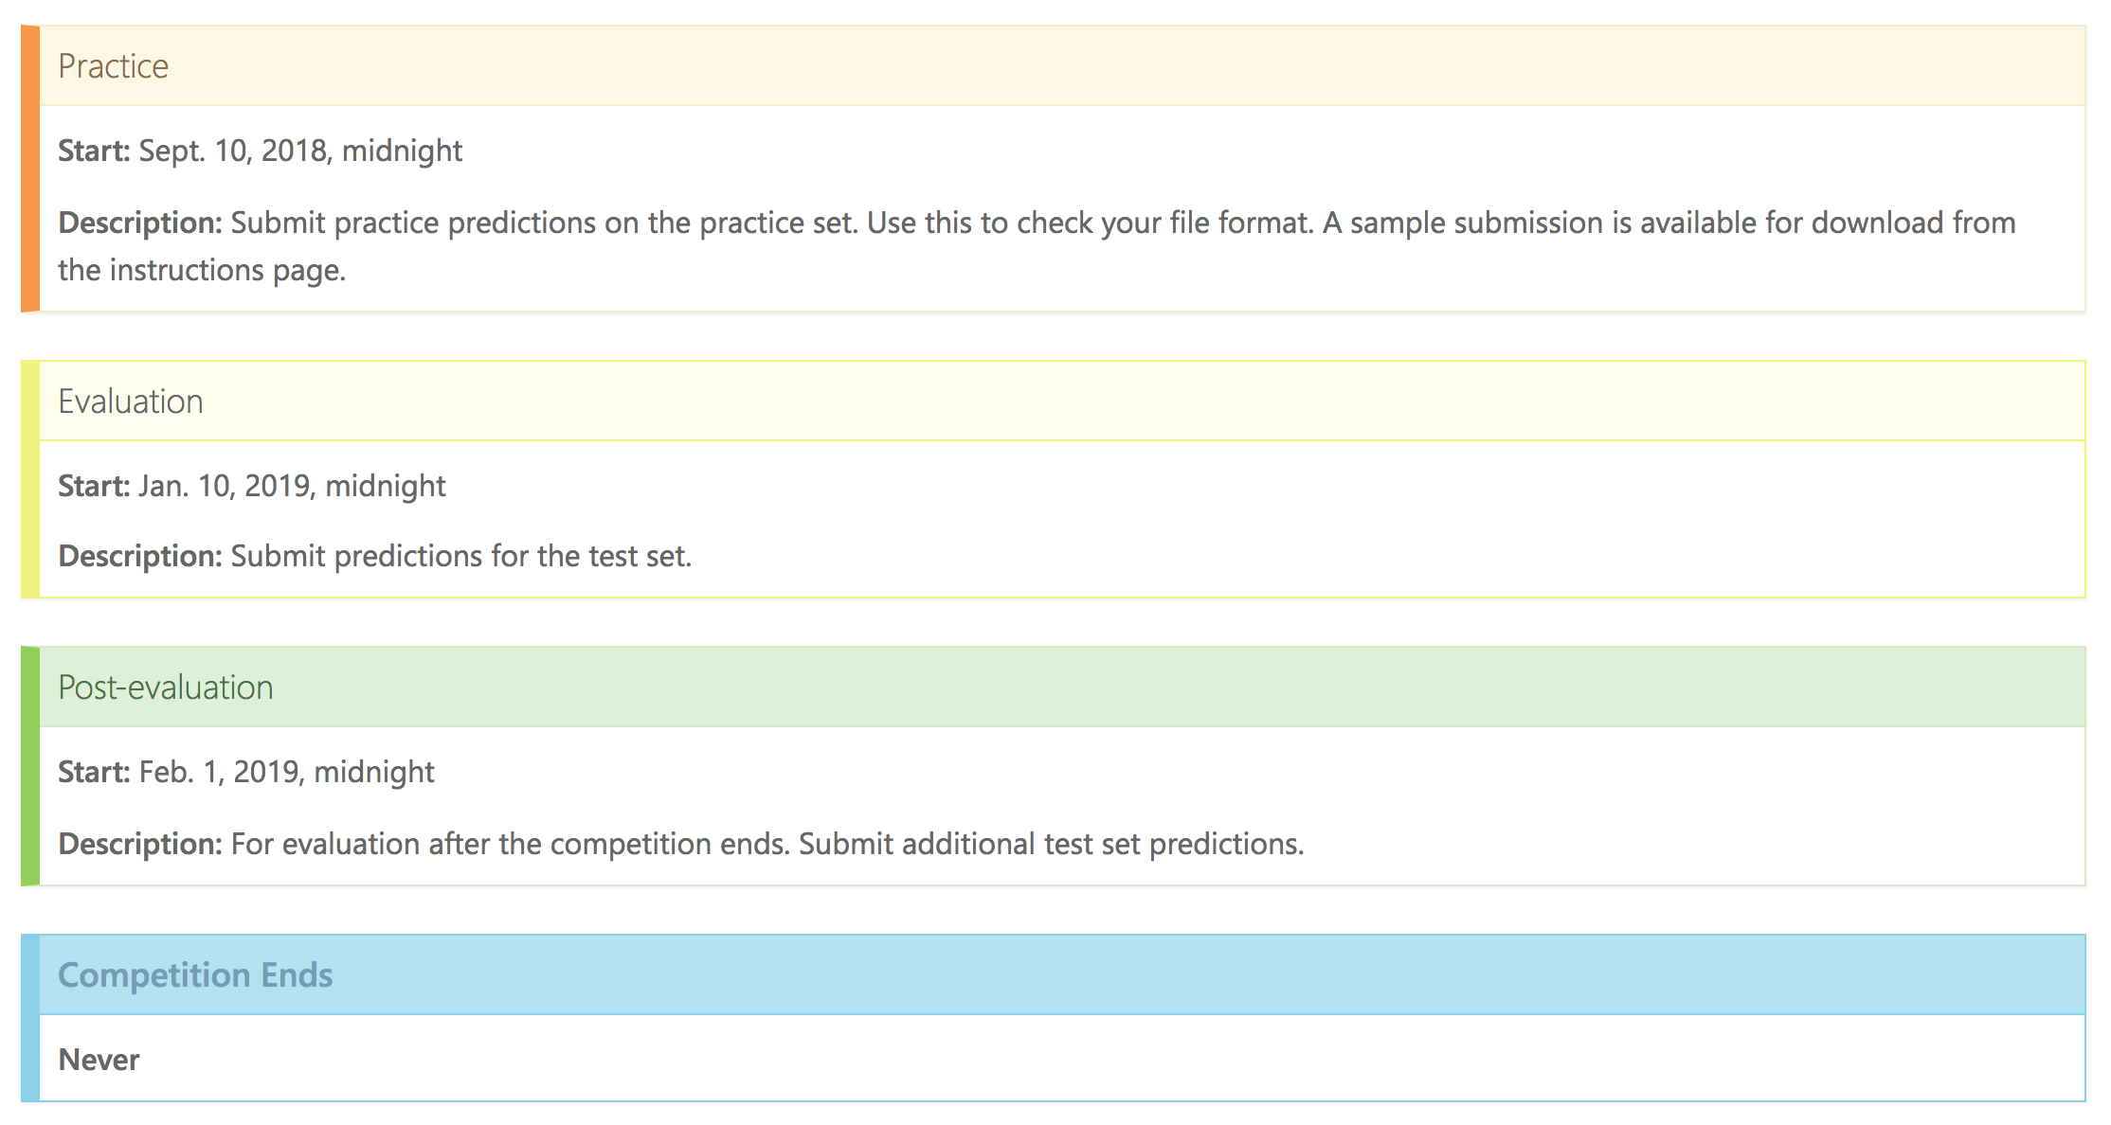
Task 6: OffensEval: Identifying and Categorizing Offensive Language in Social Media

